Slide 1

Theoretical Foundations in Nursing
An Introduction
DR. JOHN MICHAEL O. LORENA, RN
jolorena@tua.edu.ph
Notes:
Greet
Where is the attendance?
Kindly Call my attention if I will mispronounce your name
Introduce self, batch
Look for the class president, secretary
Submit all the COMs to the Secretary, Now
Last day of late registration/adding of subjects _ July 28, Monday
Last day of dropping of subjects = september 26
4 Expectations
Punctuality, No lates
Class participation, no spoon feeding
Passed the exam and get a passing grade
Attitude and behavior (basis for assessing you during the screening process next year; no IRs or any DA)
Your expectation?
In 1/4th sheet of paper, write your name and your section and write your expectations from this course.
I will be giving you 3 minutes for this activity.

Slide 2

Course Description
Deals with META-CONCEPTS of a PERSON, HEALTH, ENVIRONMENT and NURSING as viewed by the different theories.
Theories serve as a GUIDE to nursing practice and further deals with HEALTH as multi-factorial PHENOMENA
META meaning "after" or "beyond"
General condition of a person's mind and body, usually meaning to be free from illness, injury or pain
Notes:
From the Greek preposition and prefix meta meaning "after" or "beyond") is a prefix used in English to indicate a concept which is an abstraction from another concept, used to complete or add to the latter.
Broad, affected my many factors
general condition of a person's mind and body, usually meaning to be free from illness, injury or pain

Slide 3

At the end of the course, the student will be able to:
DIFFERENTIATE views given by various nursing theorists on person, health, environment and nursing
UTILIZE selected nursing theories in the care of clients

Slide 4


Slide 5
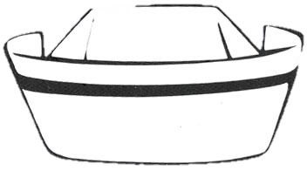
What is NURSING?
Definition

Slide 6

How do you envision yourself as a nurse?

Slide 7

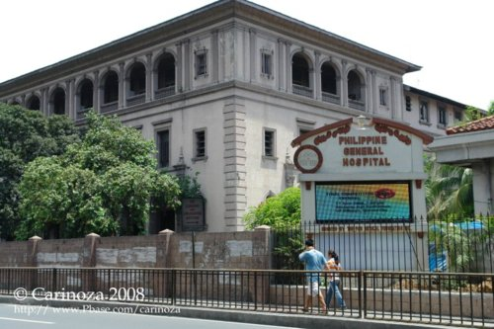

Notes:
Work in a first class hospital or work in the Philippines in a government hospital

Slide 8

Notes:
Working in an ideal set-up

Slide 9
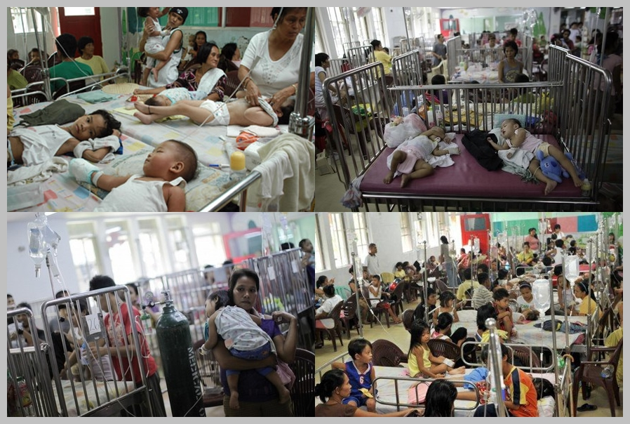
Notes:
Or work in a real third world set-up
Working as a nurse in a multi tasking job

Slide 10
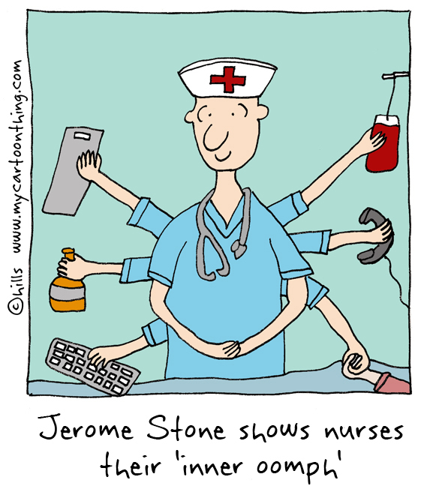

MULTITASKER
CARING
N
PRESENCE OF MIND
CRITICAL THINKER
URSE
RIGHT ATTITUDE
Notes:
Multitasking that you end up burned out
But what is really nursing.. The word nursing, what does it mean?

Slide 11

ORIGIN of the WORD
Yet the spirit of nursing has no sexual boundaries. Human beings of both sexes have a natural tendency to respond to helplessness or a threat to life from disease or injury (Donahue, 1996).
Latin word Nutrire | Nourish
French word Norrice, Nurice | Nourish
16th Century | A person, but usually a woman who waits upon or tends to the sick
19th Century | Training of those who tend to the sick and carrying out such duties under a direction of a PHYSICIAN

Slide 12
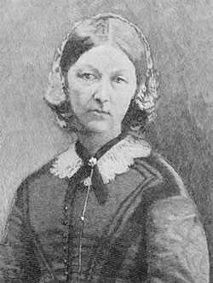
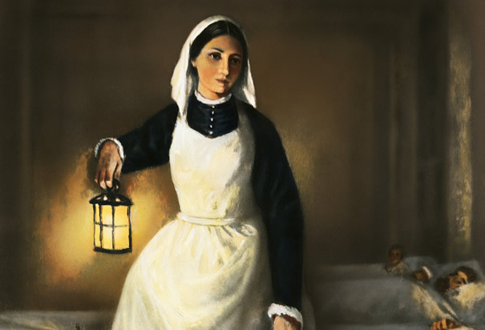
NURSING IS AN
ART
FLORENCE NIGHTINGALE
Notes:
Lady with a lamp (Crimean War)
To look into the sick soldiers who fought during the war

Slide 13
Nursing is an ART; and if it is to be made an ART, it requires an exclusive devotion as hard a preparation, as any painter’s or sculptor’s work; for what is the having to do with DEAD CANVAS OR DEAD MARBLE, compared with having to do with the LIVING BODY, the temple of God’s spirit? It is one of the Fine Arts: I had almost said, the FINEST of Fine Arts - Nightingale
Notes:
Nursing is an art; and if it is to be made an art, it requires an exclusive devotion as hard a preparation, as any painter’s or sculptor’s work; for what is the having to do with dead canvas or dead marble, compared with having to do with the living body, the temple of God’s spirit? It is one of the Fine Arts: I had almost said, the finest of Fine Arts.

Slide 14
Generally began with
FLORENCE NIGHTINGALE
  Body of educated woman
    Writings Served as a guide for establishing nursing schools and hospitals
  Mid-1800s
    Unique focus of nursing: nursing knowledge versus medical knowledge
              Put the patient in best condition
  1950s
    Development of nursing knowledge
    Nursing practice; based on principles and traditions that were handed down

Slide 15
ERAS
CURRICULUM ERA | RESEARCH EMPHASIS ERA | GRADUATE EDUCATION ERA | THEORY ERA | THEORY UTILIZATION ERA
CONTENT to study to learn how to be nurse | Embraced higher education Participation in RESEARCH = New Knowledge | MASTER’S degree programs SPECIALIZED clinical nursing practice | OUTGROWTH of the research The need for theoretical framework to build a nursing knowledge | Utilization to APPLICATION in the nursing practice

Slide 16
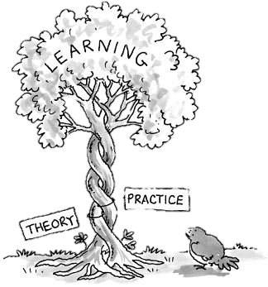
Significance of
NURSING Theory
DISCIPLINE (education) versus PROFESSION (practice)

Slide 17
DISCIPLINE | PROFESSION
Developing knowledge as BASIS for nursing practice GRADUATE programs began to open Theory development to NEW nursing knowledge Theoretical frameworks as developed by EDUCATORS CONCEPTUAL frameworks began To organize the curricula of the nursing program Creative conceptualization of nursing metaparadigms Nurses were provided with NEW PERSPECTIVES about taking care of their patients | Recognized as a PROFESSION CRITERIA for the profession was developed (Bixler, 1959) Nursing theory as a TOOL for reasoning, critical thinking and decision-making Nursing practice requires: SYSTEMATIC approach THEORIES (to provide perspectives of the patient)

Slide 18
NURSING, as defined by
ANA
PROTECTION
PROMOTION
OPTIMIZATION
PREVENTION
ALLEVIATION
TREATMENT
ADVOCACY
Nursing is the PROTECTION, PROMOTION, and OPTIMIZATION of health and abilities, PREVENTION of illness and injury, ALLEVIATION of suffering through the diagnosis and TREATMENT of human response, and ADVOCACY in the care of individuals, families, communities, and populations.
COMMUNICATOR
COMMUNICATION SKILLS

Slide 19

NURSING as defined by
ICN
Nursing encompasses AUTONOMOUS and COLLABORATIVE care of individuals of all ages, families, groups and communities, sick or well and in all settings.
Nursing includes the PROMOTION of health, PREVENTION of illness, and the CARE of ill, disabled and dying people.
Advocacy, promotion of a SAFE environment, RESEARCH, PARTICIPATION in shaping health policy and in patient and health systems MANAGEMENT, and EDUCATION are also key nursing roles.
AUTONOMOUS
COLLABORATIVE
PROMOTION
PREVENTION
CARE
PROMOTION OF SAFE ENVIRONMENT
RESEARCH
PARTICIPATION
MANAGEMENT
EDUCATION
ROLES
RESEARCHER
POLICY MAKER
MANAGER
EDUCATOR

Slide 20

But is NURSING …..
All professions are occupations, but NOT all occupations are professions.

Slide 21

Although the debate is ongoing, it can be successfully argued that nursing is an ASPIRING, EVOLVING profession.
(Logan, et al., 2004; Rutty, 1998; Schwirian, 1998; Smith, 2000)
NURSING
  SUBSERVIENT to medicine
  Not STANDARDIZED
  Autonomy is INCOMPLETE
    Dependent on medicine to direct much of its practice
Learned VOCATION that has a status of SUPERIORITY
BENEFICIAL to the members of the society
OCCUPATION
PROFESSION
NEVER WILL BE
REDUNDANT
JOB OR CAREER
Earning just for MONEY
GOAL
Earning MONEY to LIVE
CHARACTERISTICS:
Knowledge base
Power and authority over training and education
Altruistic service
Has Code of Ethics
Has AUTONOMY
Accountable to the public
Notes:
Subservient = obedient

Slide 22
What is a
THEORY?
Definition

Slide 23

Theory
ORIGIN: “THEORIA” – speculate
GREEK WORD
Notes:
Form a conjecture (opinion) about a subject without firm evidence
Idea or feeling or that it explains something

Slide 24
THEORY
A group of related concepts that PROPOSE action that GUIDE practice
SYSTEMATIC explanation of an event in which concepts are IDENTIFIED and relationships are PROPOSED and PREDICTIONS are made

Slide 25
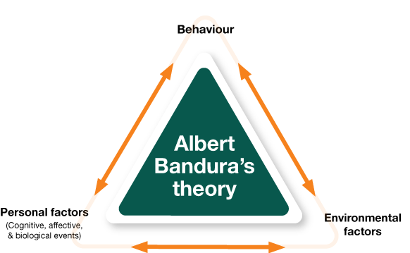
SHAPES
ARROWS
Notes:
DESCRIBES a PHENOMENA!
Triangle with an arrow, interconnected with one another (3 factors)
Albert Bandura, psychologist, professor emeritus from Stanford University
People learn thru observing other’s behavior, attitudes and outcomes of those behaviors
Most human behavior is learned observationally thru modelling from observing others, one forms an idea of how new behaviors are performed

Slide 26
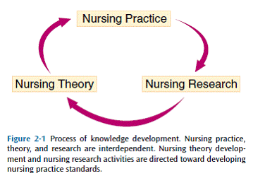

Slide 27
Propositions/ assumptions/ concepts
That are SYSTEMATICALLY organized
THEORY
In order to VIEW
PHENOMENA
A fact or situation that is observed to exist or happen
This diagram explains the relationship of concepts/assumptions/propositions with theory and phenomena
Notes:
This diagram explains the relationship of concepts/assumptions/propositions with theory and phenomena

Slide 28
NURSING Theory
A GROUP of interrelated concepts that are DEVELOPED from various studies of disciplines and related experiences
AIM:
      View the essence of nursing care

Slide 29
BEDSIDE
(Most of the TIME)
NURSING CARE
THEORY
DESCRIBES
EXPLAINS
PREDICTS
PRESCRIBES
Notes:
IMPORTANCE OF EXPRESSING NURSING THEORY IN PROVIDING DIRECTION TO NURSING CARE

Slide 30
Other Terms Related to THEORY

Slide 31
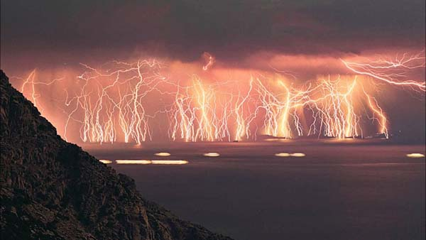
PHENOMENON
Is a thing, event or activity that we perceive through our senses
  When experience and sensory and intuitive data become coherent as a whole then we have a phenomena
Represents the subject-matter of a discipline

Slide 32

IDEAS
A product of organized intellectual thought about the origin, nature, boundaries and significance of phenomena
  Example: sun influences plant growth

Slide 33

CONCEPTS
Words or phrases that IDENTIFY, DEFINE, and ESTABLISH structure and boundaries for the phenomena and ideas generated by phenomena
    Sunlight, time, plant growth (conceptual relationships)
LABEL used to DESCRIBE a PHENOMENON or group of phenomena
MENTAL IMAGE of a PHENOMENON
  Major component of theory
    Can be abstract
    Can be concrete
Notes:
Abstract (HOPE); indirectly observable
Concrete (Height and Weight); observable

Slide 34
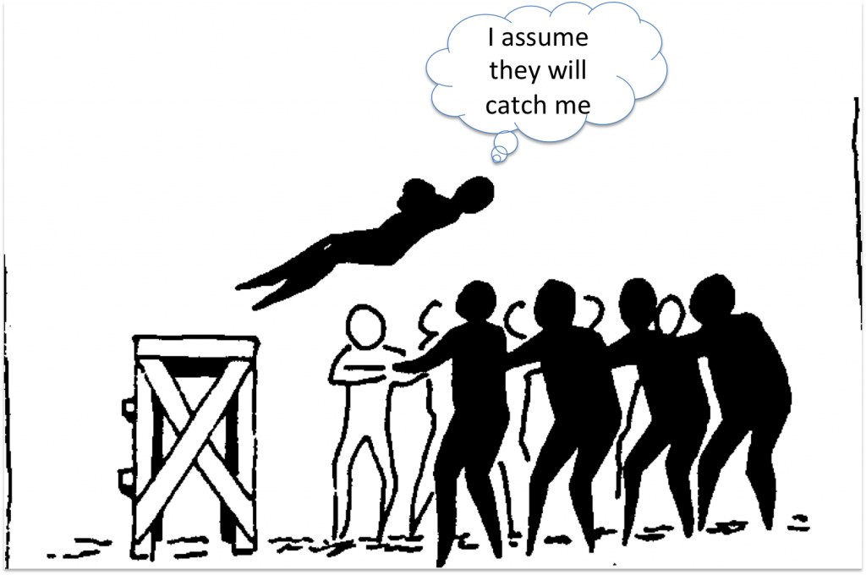
ASSUMPTION
Assumed to be true from which conclusion can be drawn

Slide 35
What you BELIEVE in
A TRUTH, build on FACTS
That is FOUNDATION to other truths
  Example:

Slide 36
PROPOSITIONS
FORMAL statement that affirms or denies something and is either true or false
Identifies the DIRECTION of a relationship between concepts and DEFINES the nature of that relationship
  Example: increasing the amount of time a plant is in sunlight increases plant growth
    can be called also as RELATIONAL STATEMENTS

Slide 37
HYPOTHESES
FORMAL STATEMENTS that translate propositions into formal statements DESCRIBING an expected RELATIONSHIP between concepts
Stated in a way that can be PROVEN or DISPROVEN through research
  EXAMPLE: Television and Attitude and Behavior of Toddlers
Notes:
Television has no effect on the attitude and behavior of toddlers

Slide 38
RESEARCH
An INQUIRY or INVESTIGATION that assists in validating, refining, or generating theory
Example: Evidence-based practices

Slide 39
FACTS
Factual meaning TRUE
A DOING
What actually happened
Observations consistently proved true over time
  Example: presence of mother VERSUS baby crying

Slide 40
LAW
WRITTEN rules on behavior
Built on FACTS and PRINCIPLES that guides intellectual thought and behavior
  Example:
    Student decorum as written in the Student Handbook
    Rules during mealtime

Slide 42
Proposition.
Concept.
Suggest something
Abstract
THEORY
Phrases = STRUCTURE
RESEARCH.
Ideas.
INQUIRY
Thought
HYPOTHESES.
Assumption.
TRUE without proof/evidence
Statements= RELATIONSHIP
Principle.
Facts.
CONCEPTS+PROPOSE+GUIDE
TRUE
Observed
What you believe
Phenomenon.
Law.
Written
Subject matter

Slide 43
Thank You.

